Slide 1
Next Gen Test Automation Framework

Slide 2
Why?
Need an automation framework that can:
Maximize efficiency - Run parallel tests for faster execution when a build is deployed
Increase productivity - Generate test reports, logs, screenshots in case of failure, and notifications
Reduce costs - Update newly added Test Rail run results with additional comments that can expedite debugging and provide rapid feedback

Slide 3
What?
Automation stack:
Github - code repository
Jenkins - continuous integration. Stores build history, test results, reports, and artifacts
TestNG - automation framework for parallel test execution with flexible configurations
Selenium - automates browsers. Implemented Page Object model that maps pages to the UI to reduce duplicated code and apply changes in one place
Java and Scala - programming language
Log4J – logging
Maven - build deployment
Sauce Labs - cloud service that can run parallel tests with multiple platform/browser/version combinations. Saves screenshots and video of sessions
Test Rail - test case management

Slide 4
Where?
UI
Run tests locally on the Selenium Grid when writing/debugging tests
Run tests in the cloud on Sauce Labs when a build is deployed
API
Run tests locally when writing/debugging tests
Runs in the background

Slide 5
When?
Jenkins should build the test suite project automatically when a build is pushed
Still need to identify the dependencies
Post commit git hook
On demand

Slide 6
How?

Slide 7
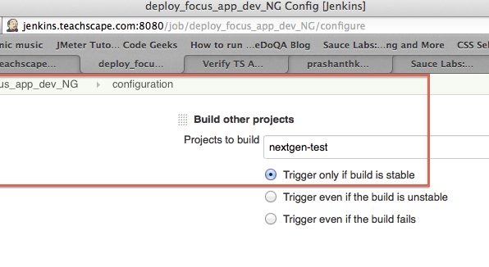
Jenkins build on push

Slide 8
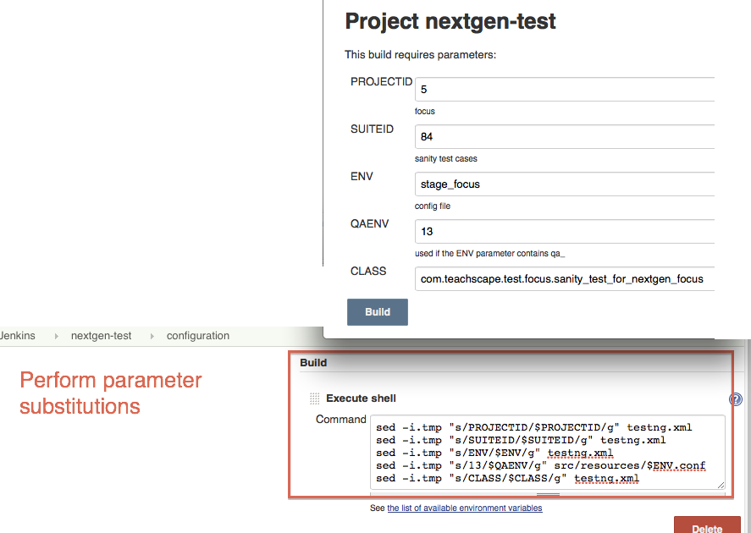
Parameterized build

Slide 9
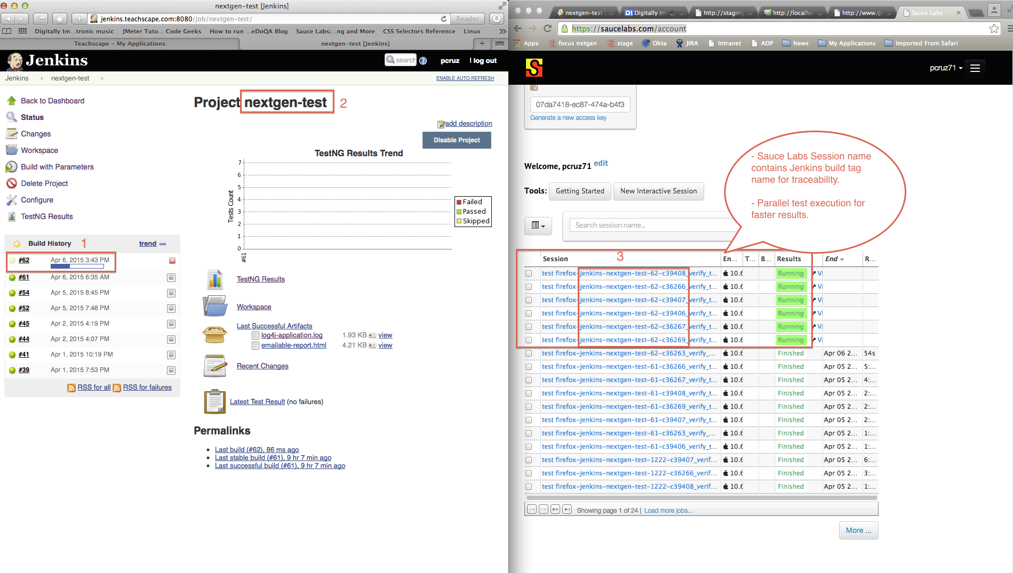
Jenkins + Sauce Labs
Notes:
adsfasd

Slide 10
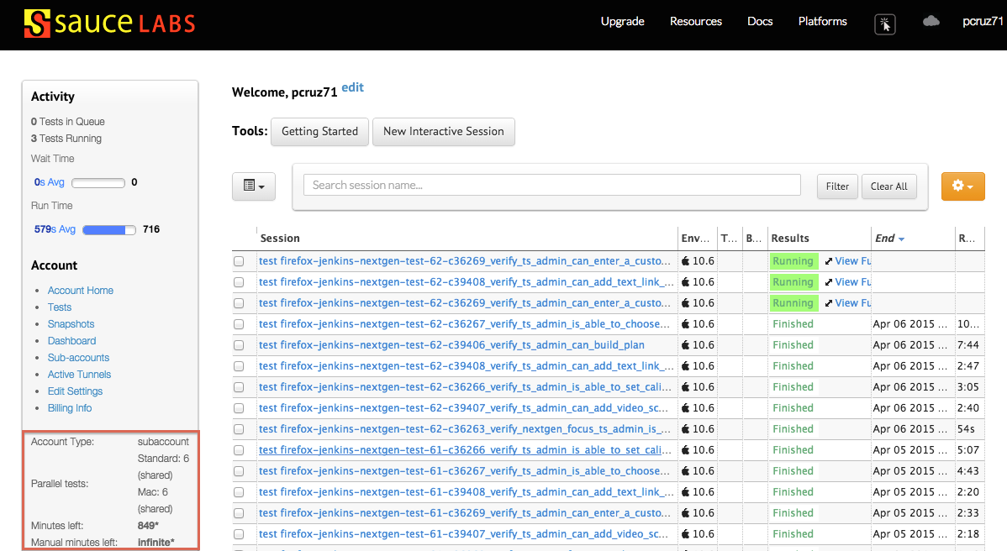
Sauce Labs cloud service

Slide 11
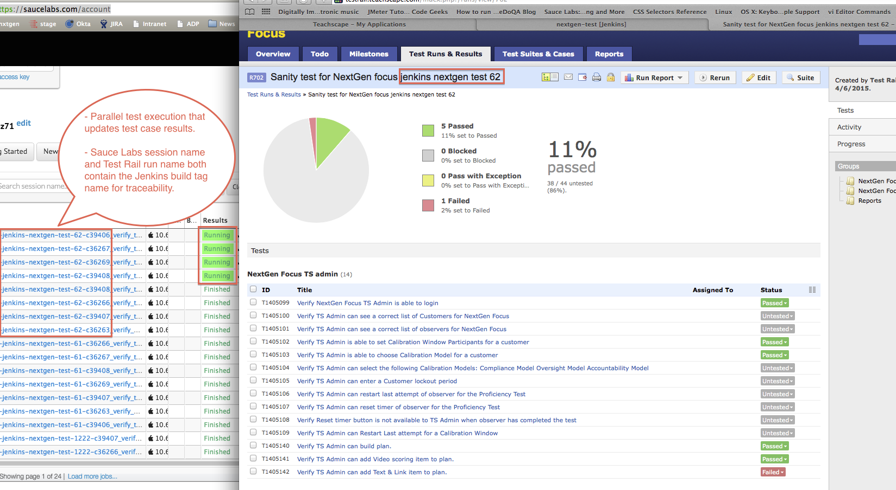
Sauce Labs + Test Rail

Slide 12
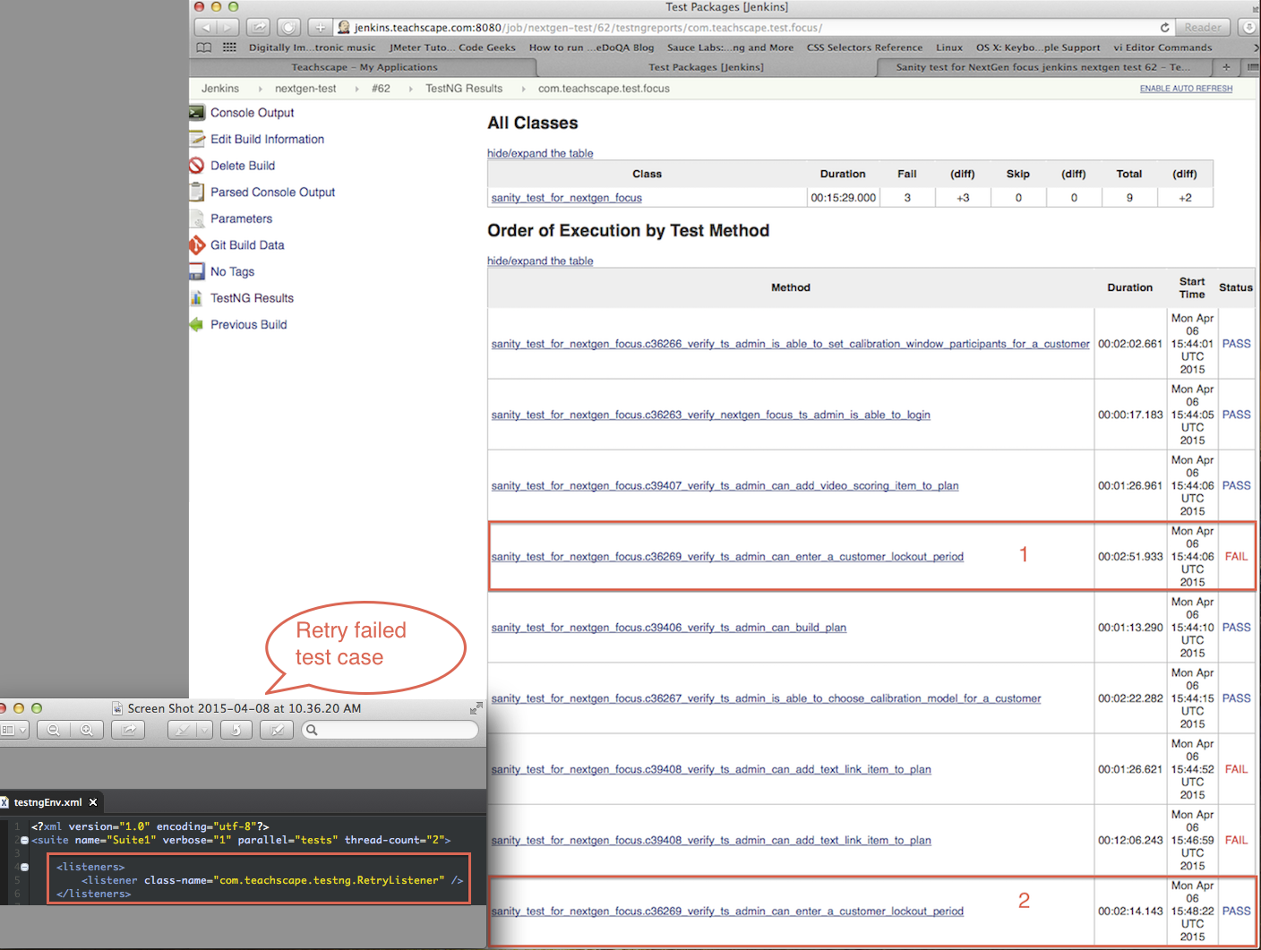
Retry a failed test case

Slide 13
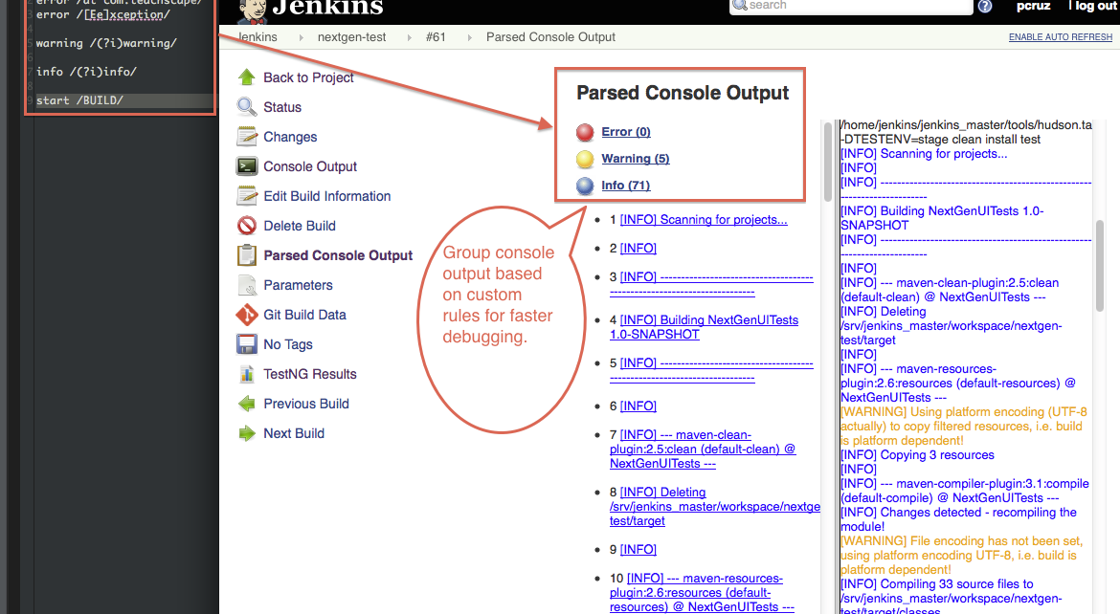
Parsed Console Output

Slide 14
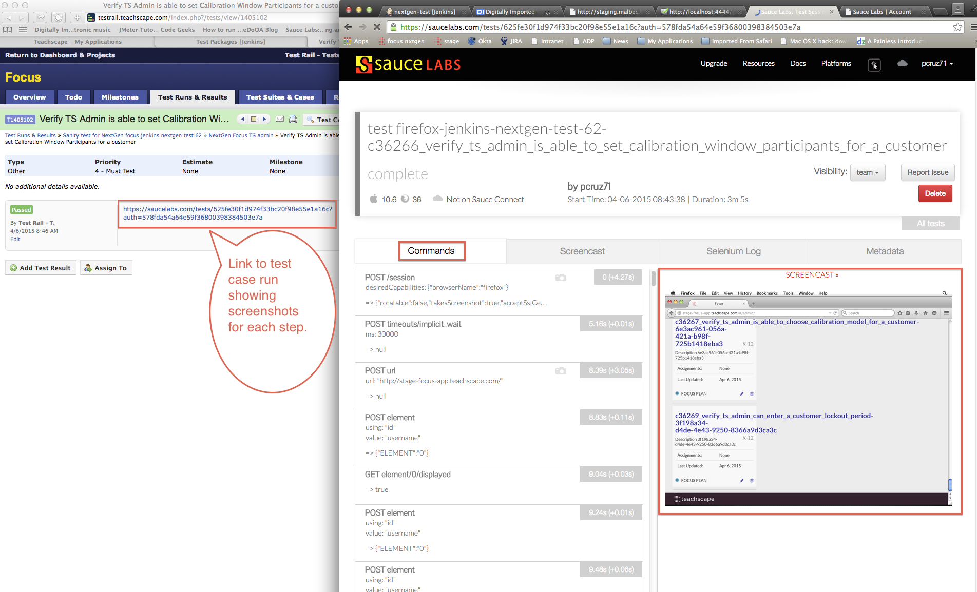
Screenshots

Slide 15
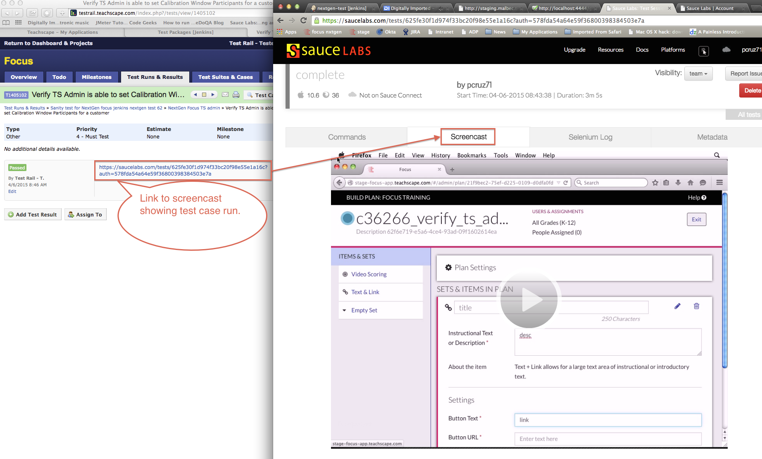
Video

Slide 16
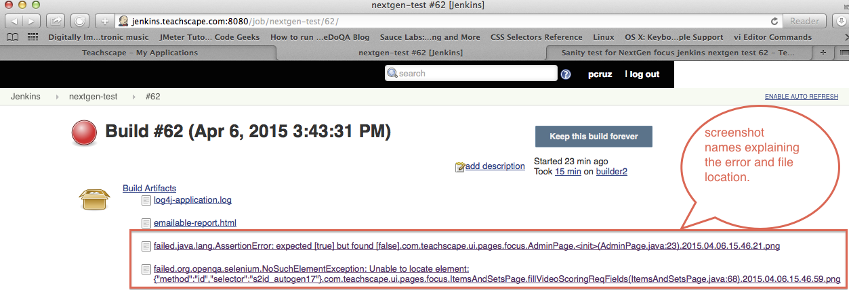
Build Artifacts

Slide 17
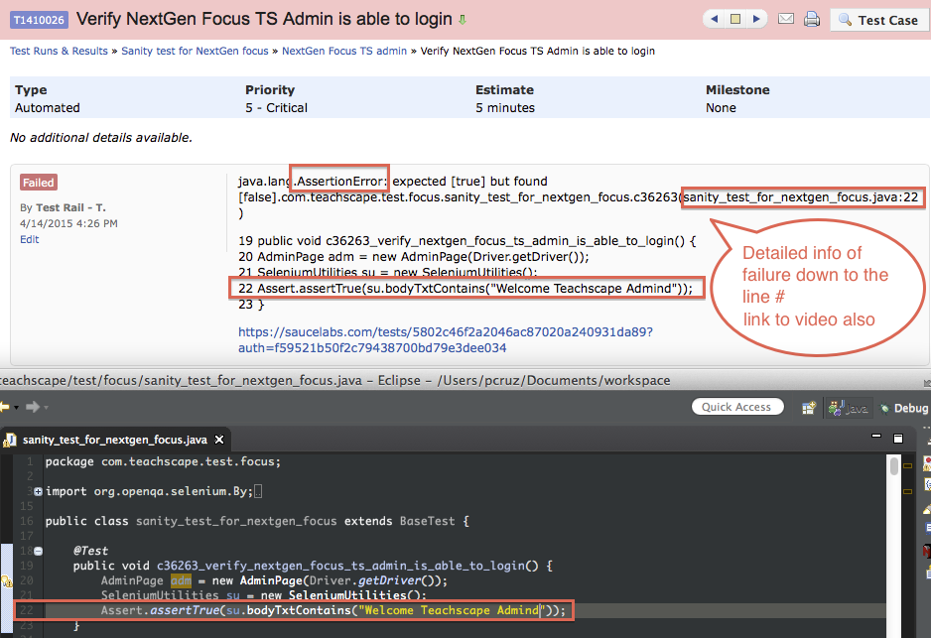
Test Rail comments

Slide 18
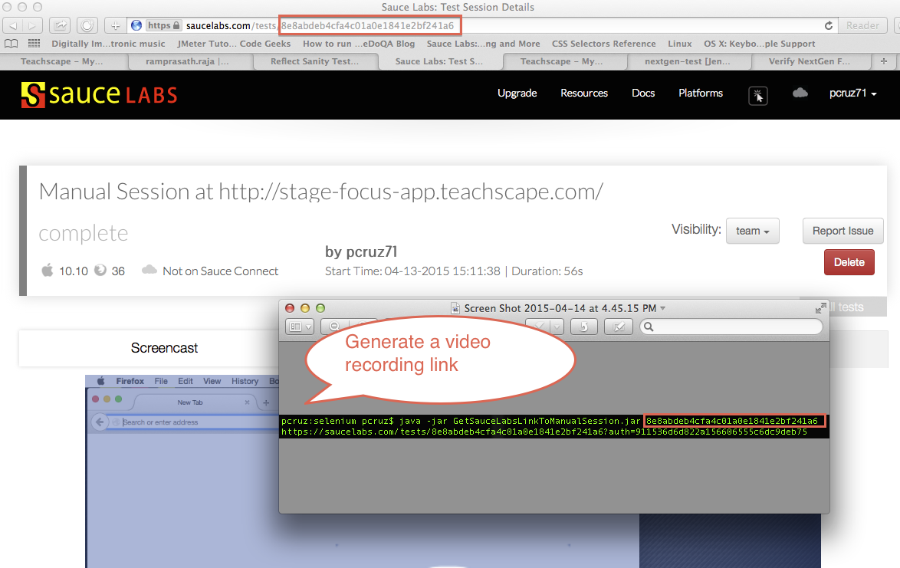
Recorded manual sessions

Slide 19
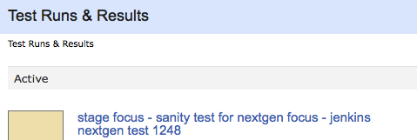
Naming convention

Slide 20
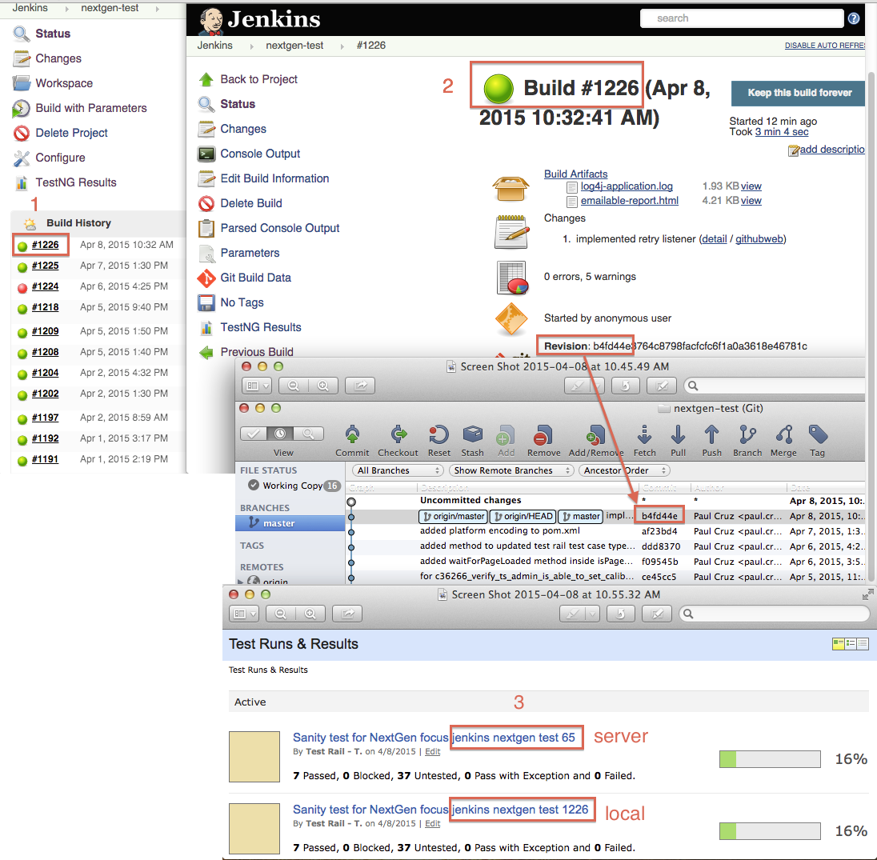
Stability

Slide 21
Q & A Thank you!

